Slide 1
Smart Cafeteria & Resource Queue Optimizer
A Progressive Web App with live queue management and Discrete Event Simulation
Group The OG · CSY2088 Group Project
Smrit Chaulagain (Leader), Subham Khadka, Abish Aryal
Arpan Somnath Adhikari, Dhirendra Singh Khadka

Slide 2
The problem
Problem statement
What it looks like at NAMI
Large student demand within a limited timeframe, fixed serving capacity, and no data-driven queue system. Students wait unnecessarily, and staff and management face unpredictable rushes without the information to allocate resources.
Hundreds of students a day, most of them in the 9–10 AM break
15–20 minutes of waiting to be served
No record of past queues, so counters run on guesswork
Staff shout across the counter when food is ready

Slide 3
What we aim to achieve
Design and build a PWA that combines Discrete Event Simulation with live queues and order management, to reduce student wait times at the NAMI cafeteria and give managers evidence instead of guesswork.
Study peak-hour queue problems through interviews and observation
Build a DES model of arrivals, service times and counters
Live queue length and estimated wait times
Prediction system comparing the model with the live cafeteria
Pre-ordering: browse, order, track and get notified
Management dashboard with roles, reports and simulation
Test and evaluate with real users

Slide 4
What we will build
Students
See the live queue and estimated wait, browse the menu, pre-order, track the order and get notified when it is ready.
Cafeteria staff
An order board for pre-orders and walk-ins, order status updates, and open/close counters.
Managers
A dashboard with reports, and a simulation to test staffing and counter changes before making them for real.
All of it in one Progressive Web App, a website that behaves like an app, so there is nothing to download from an app store.

Slide 5
What already exists
SYSTEM TYPE | LIVE QUEUE | PRE-ORDERING | WHAT-IF SIMULATION | USED DAILY BY MANAGERS
University ordering apps | Partial | Yes | No | Yes
Commercial queue systems | Yes | No | No | Yes
Academic DES studies | No | No | Yes | No
Smart Cafeteria | Yes | Yes | Yes | Yes
Nothing on the market covers all four. We combine the practical side of PWA pre-ordering with a live simulation layer, in one application on the same data.

Slide 6
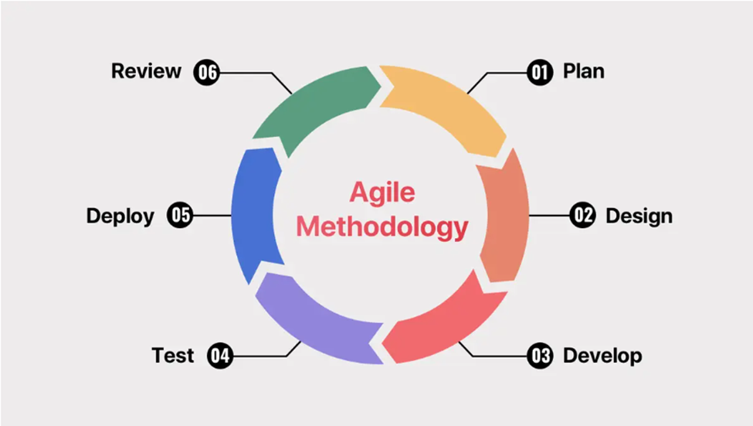
Methodology: Agile
What it is
Building in short cycles. Each cycle delivers a working part, it gets tested, and what we learn shapes the next cycle.
How we iterated
Take the next part from the ranked requirements
Build it as a working piece
Test it before starting the next sprint
What we did: five sprints
SPRINT 1
Foundation and observation data
SPRINT 2
Live queue and DES connection
SPRINT 3
Pre-order flow, staff order board, counter control
SPRINT 4
Management dashboard and what-if simulation
SPRINT 5
Authentication, security, PWA service worker, deployment

Slide 7
Requirement analysis
How we did it
What we found
Interviewed students, cafeteria staff, the manager and college administration
Every group described the same rush-hour problem
Sorted needs into functional and non-functional requirements
Ranked them Must / Should / Could (MoSCoW): 18 functional, 10 non-functional
One system for all groups was the right call
Students won't install an app, so a PWA
Pre-ordering alone won't shorten the queue, so staff need an order board
Manager and admin want to test changes, so simulation is central
Admin: no individual student orders in reports, so privacy is built into the database

Slide 8
Literature review
Simulation studies
DES has been used to cut campus dining queues by reallocating counters and staff, to size dining resources under changing demand, and to validate dynamic staffing with SimPy.
Digital pre-ordering
At UC Berkeley, lunch waits fell from about 45 to about 20 minutes after mobile ordering. Tianjin University of Science and Technology and MealPe report similar effects.
The gap
Simulation tools rarely reach managers, and pre-order apps don't answer "what if we open one more counter?". This project links both.

Slide 9
Technology review
Why DES and SimPy
The stack
DES models the cafeteria as events: a student arrives, joins the queue, service starts, service ends, they leave. SimPy is free, well documented and light enough for a laptop; AnyLogic and Arena carry licence costs.
Svelte + Vite: fast, no runtime, smooth on low-end devices
Express: simple REST API, same language as the frontend
Socket.io: pushes queue and order changes instantly
MySQL: relational, easy to run
JWT + bcrypt: stateless login, standard password hashing
Python + SimPy + Flask: SimPy runs the model, Flask serves it
Why a PWA
Students said they would not install an app. A PWA needs no download or account, uses almost no storage, and one codebase serves Android, iPhone and desktop.

Slide 10
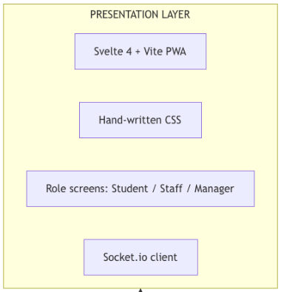
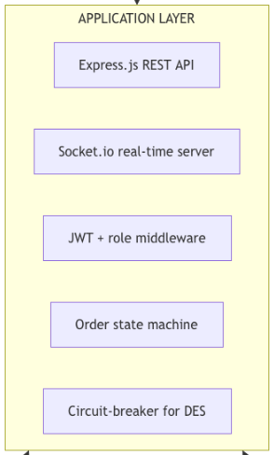
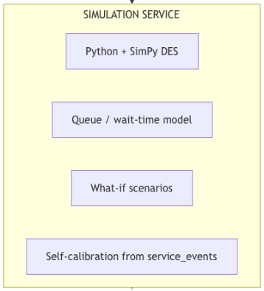
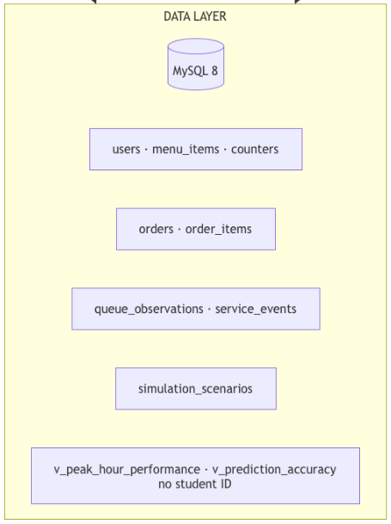
System architecture
Presentation port 80
Application port 4000
Simulation port 5001
Data port 3306
Svelte PWA, a screen per role
Login, order rules, live updates
SimPy estimates and what-ifs
MySQL and two privacy views

Slide 11
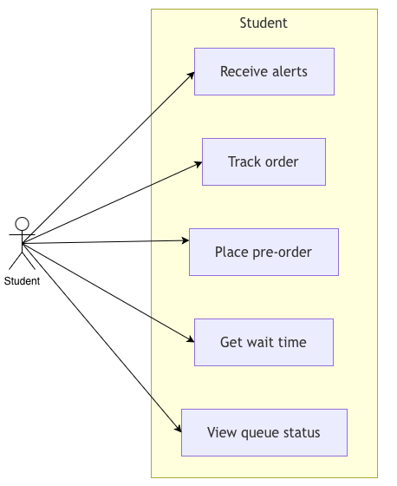
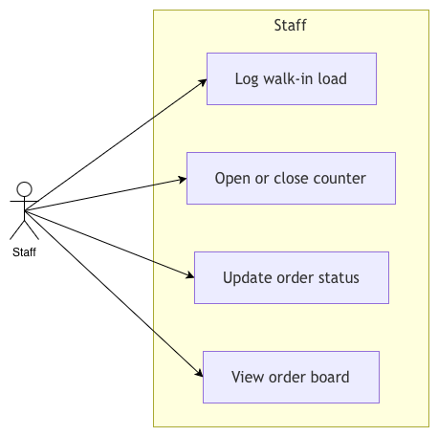
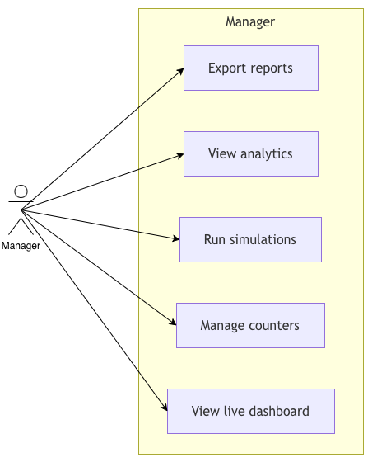
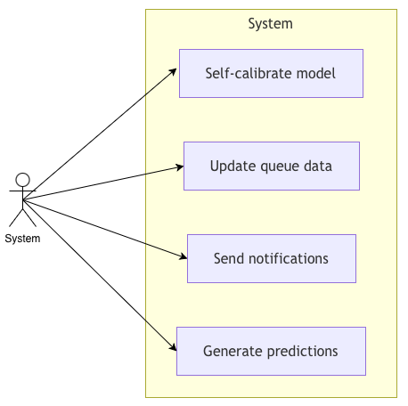
Use cases: four actors, one system
Student
Staff
Manager
System
View queue, get wait time, pre-order, track, get alerts
Order board, update status, open or close counters
Live dashboard, simulations, analytics, reports
Predictions, notifications, self-calibration

Slide 12
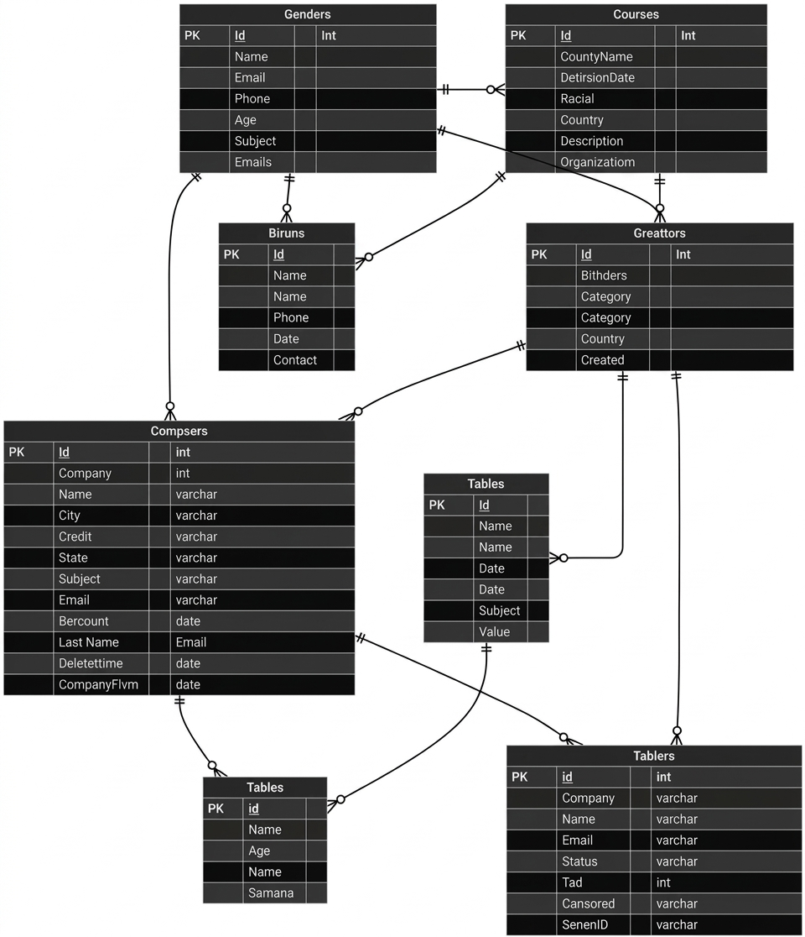
Database design
Eight tables and two privacy views, in MySQL with foreign keys.
Users, menu items, counters
Orders and their items
Queue snapshots, measured service times, saved what-if runs
Reports use summarised views only: never student IDs
Entity relationship diagram

Slide 13
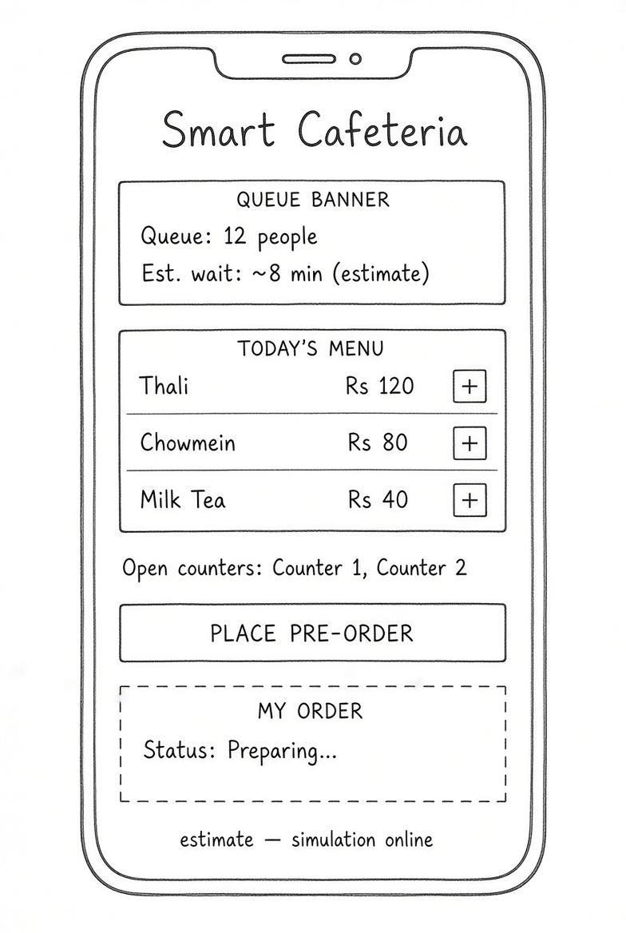
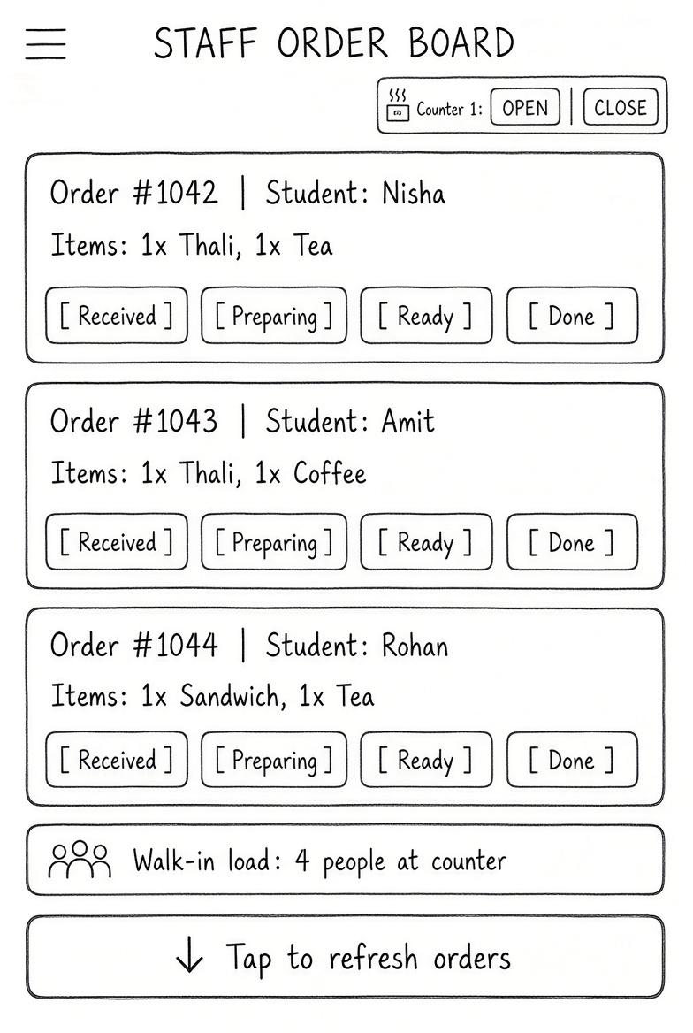
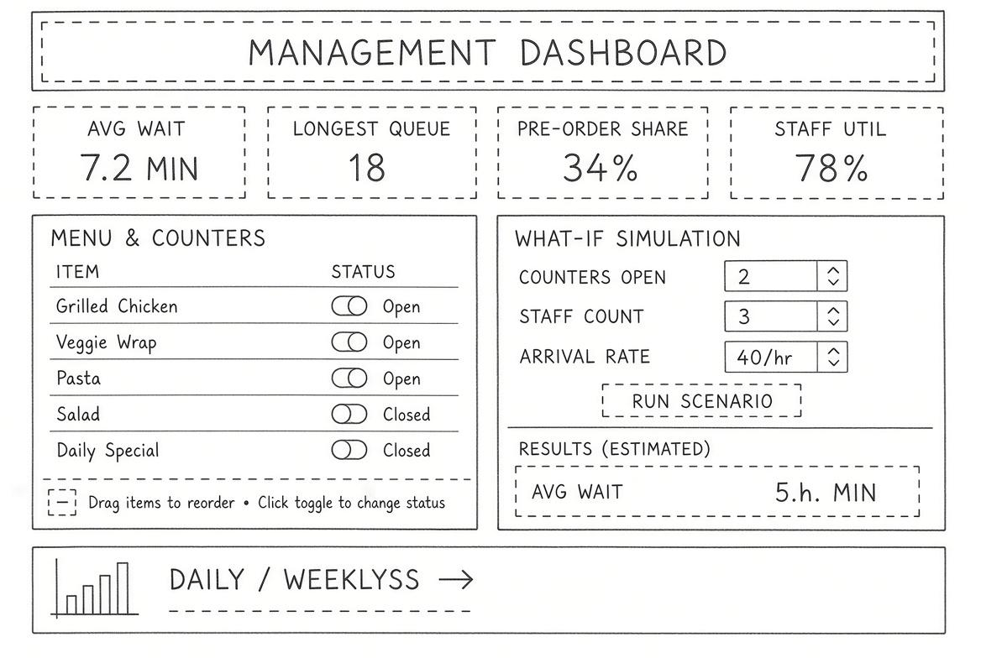
Low-fidelity wireframes
Student
Staff
Management

Slide 14
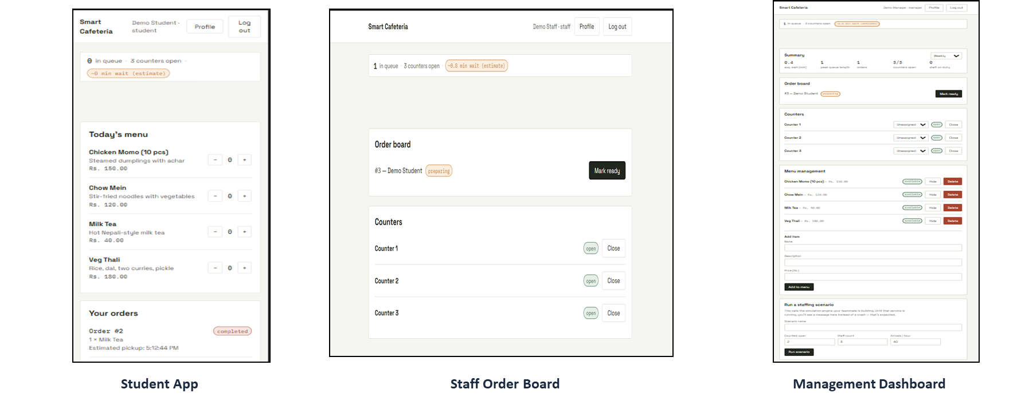
Product screens

Slide 15
Simulation results
Live estimate: a SimPy model seeded with the students in the queue right now, 8 short runs
No answer within 1.5 seconds: the app falls back to a simple estimate, labelled approximate
The model recalibrates every 10 minutes from measured service times
What-if tests compare setups, such as 2 counters against 3, and return average wait, queue length and confidence intervals
In testing, a queue of 6 with 2 counters and 2.5 min service gave about 7.5 min, labelled as an estimate

Slide 16
Testing
12 of 12 unit tests passed
10 of 10 integration tests passed
Unit tests check single functions.
Integration tests check full flows, such as a pre-order going from the student to the staff board and back as a ready notification.
AREA | WHAT WE CHECKED | UNIT | INTEGRATION | PASSED
Logins and role isolation | Logins for 4 roles, student refused on staff pages, bcrypt password hashing | UT-01, 02, 12 | IT-03 | 4 of 4
Queue behaviour | Queue length and wait estimate (queue of 6, 2 counters: 7.5 min), shown live without refresh | UT-03, 04 | IT-02 | 3 of 3
Ordering and status flow | Place order, status flow, illegal status change rejected, full pre-order journey, menu edits | UT-05, 06, 07 | IT-01, 10 | 5 of 5
Counter controls | Closing a counter updates every student and management screen live through Socket.io | UT-08 | IT-04 | 2 of 2
Simulation and fallback | 2 vs 3 counter what-if, fallback with approximate label, circuit breaker opens after 3 failures | UT-09, 11 | IT-05, 06, 07 | 5 of 5
Privacy and offline use | Reports hold summarised figures only, no student IDs; PWA opens offline with a clear message | UT-10 | IT-08, 09 | 3 of 3

Slide 17
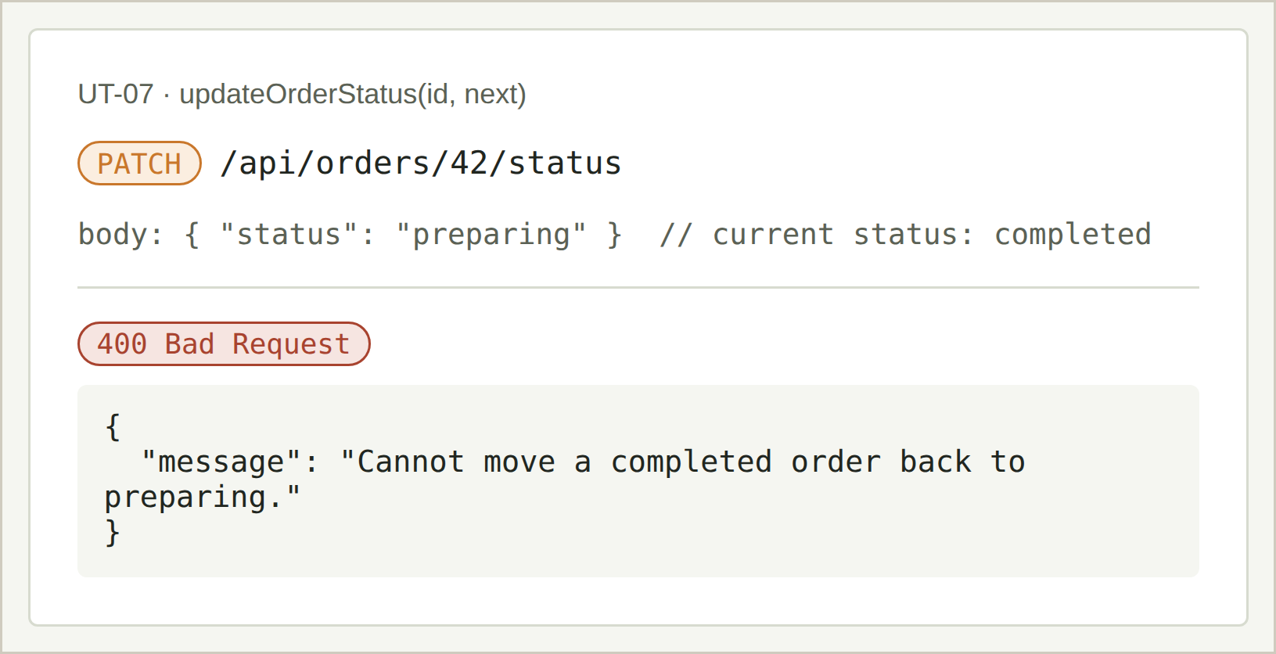
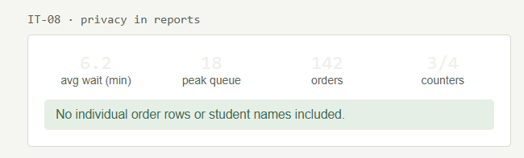
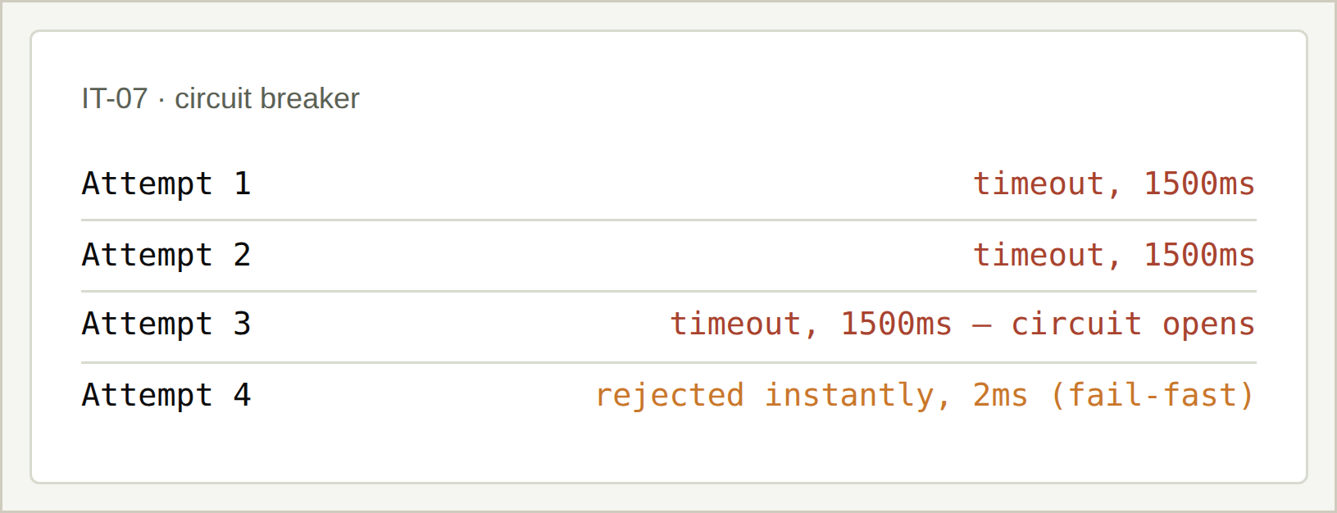
Test evidence
Privacy test: no student or individual order record is shown only.
Unit test: a finished order can't go back to "preparing". The server rejects it (400).
Circuit breaker: after 3 timeouts the circuit opens; attempt 4 is rejected in 2 ms.

Slide 18
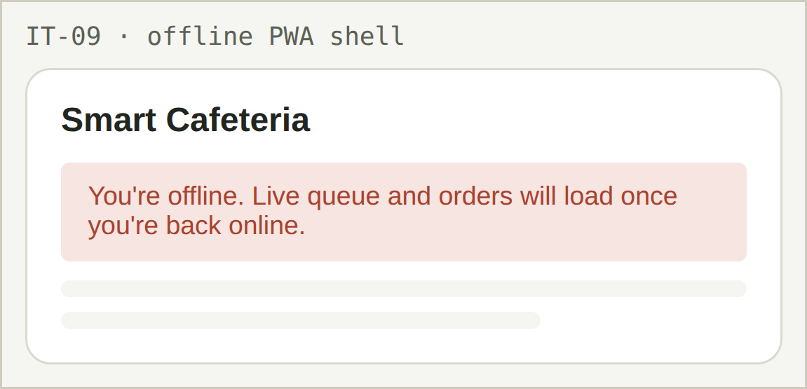
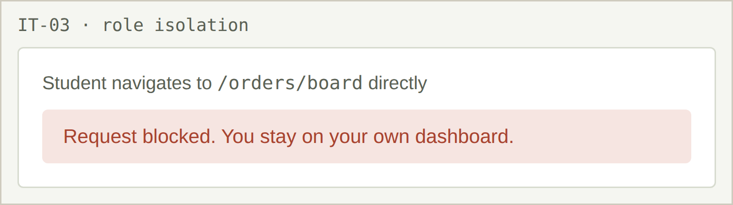
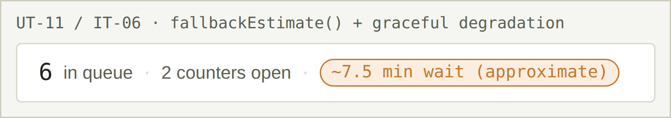
Test evidence
Integration test: a student opening the staff board is blocked.
Installed on the home screen and opened offline: a usable shell that says live data is unavailable.
Simulation engine stopped: queue length still shows, wait marked approximate.

Slide 19
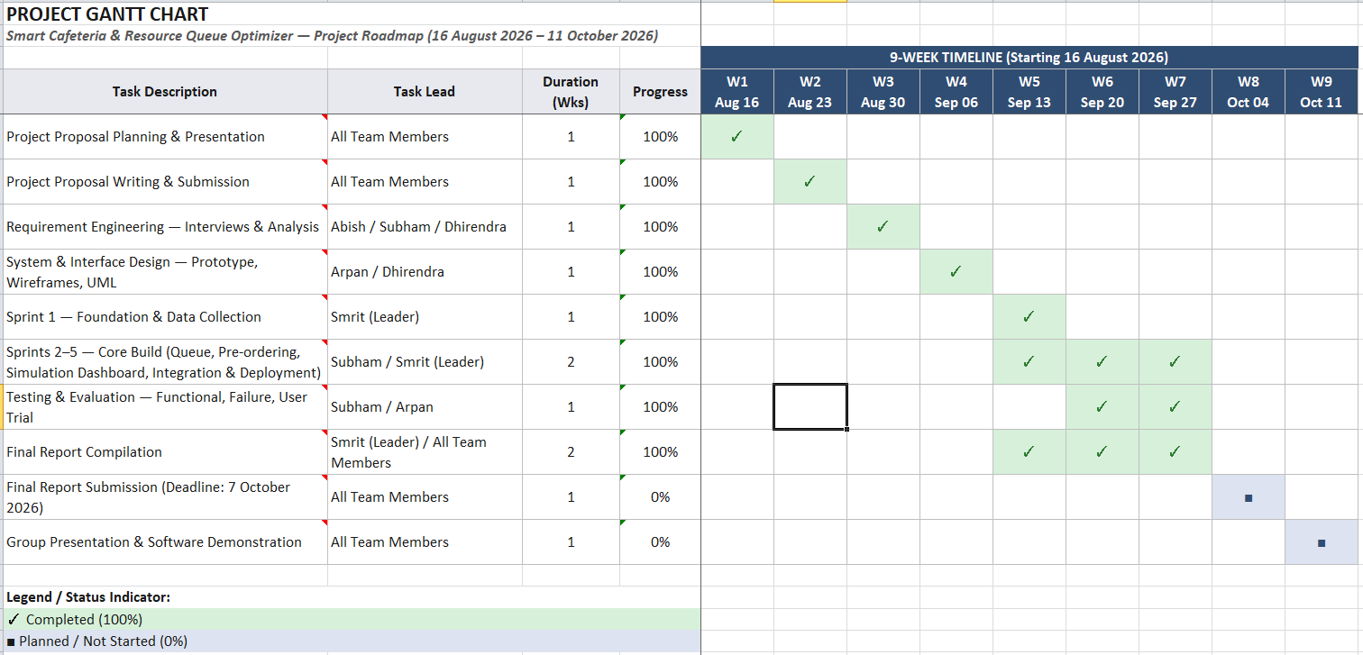
Project Timeline

Slide 20
Evaluation
A limited trial with volunteer students and cafeteria staff: a set list of tasks first, then free use.
Users liked
They asked for
Limits and future work
Ready notification
Checking the queue without walking over
Staff order board, no calling out numbers
Wait estimates without logging in
Alerts when the browser is closed
Sound alerts for staff
Short trial, few participants
Live updates lagged with many users
Walk-ins logged manually
Next: longer pilot, staffing recommendations, card payment, demand forecasting, multiple cafeterias

Slide 21
Thank you
Smart Cafeteria & Resource Queue Optimizer · Group The OG
Smrit Chaulagain 20251105 · Subham Khadka 20251101 · Abish Aryal 20251007 · Arpan Somnath Adhikari 20251015 · Dhirendra Singh Khadka 20251025

